Slide 1
Universal Health Care
Name
Institution
Date

Slide 2

Universal Health Coverage
Universal health coverage, commonly known as UHC is a healthcare policy that aims to ensure that all individuals and communities receive health services without financial hardships ("What is universal health coverage?," n.d.).
Notes:
Universal Health Coverage is a healthcare program developed by the World Health Organization (WHO) that all individuals and communities receive the health services they need without suffering financial hardship.
It includes the full spectrum of essential, quality health services, from health promotion to prevention, treatment, rehabilitation, and palliative care across the life course.

Slide 3

WHO’s Position on UHC
The United Nations identified UHC as one of its targets when developing the Sustainable Development Goals (SDGs) in 2015.
This target was later reaffirmed by the United Nations General Assembly High Level meeting on UHC in 2019 ("What is universal health coverage?," n.d.).
According to WHO, countries that makes progress towards achieving UHC will also make progress towards achieving other health-related goals and targets (Reich et al., 2016).
Notes:
Achieving UHC is one of the targets the nations of the world set when adopting the SDGs in 2015. Countries reaffirmed this commitment at the United Nations General Assembly High Level Meeting on UHC in 2019. Countries that progress towards UHC will make progress towards the other health-related targets, and towards the other goals. Good health allows children to learn and adults to earn, helps people escape from poverty, and provides the basis for long-term economic development.

Slide 4

Goal of UHC
Ensuring that all people obtain the health services they need without suffering financial hardship when paying for them ("Universal health coverage (UHC)," 2021).
Notes:
The Goal of UHC is to Protect people from the financial consequences of paying for health services out of their own pockets reduces the risk that people will be pushed into poverty because unexpected illness requires them to use up their life savings, sell assets, or borrow – destroying their futures and often those of their children.

Slide 5

UHC COMMITMENT
WHO contributes to achieving the Thirteenth General Program of Work 2025 target that 1 billion more people benefit from UHC, while also contributing to the 2 other billion targets of 1 billion more people better protected from health emergencies and 1 billion more people enjoying better health and well-being ("What is universal health coverage?," n.d.).
WHO also contributes to its mission of the right to the highest attainable standard of health, to Health for All and the sustainable development goals (SDGs).
Notes:
Good health allows children to learn and adults to earn, helps people escape from poverty, and provides the basis for long-term economic development.
WHO contributes to achieving the Thirteenth General Program of Work 2025 target that 1 billion more people benefit from UHC, while also contributing to the 2 other billion targets of 1 billion more people better protected from health emergencies and 1 billion more people enjoying better health and well-being. It also contributes to WHO’s mission of the right to the highest attainable standard of health, to Health for All and the SDGs.

Slide 6
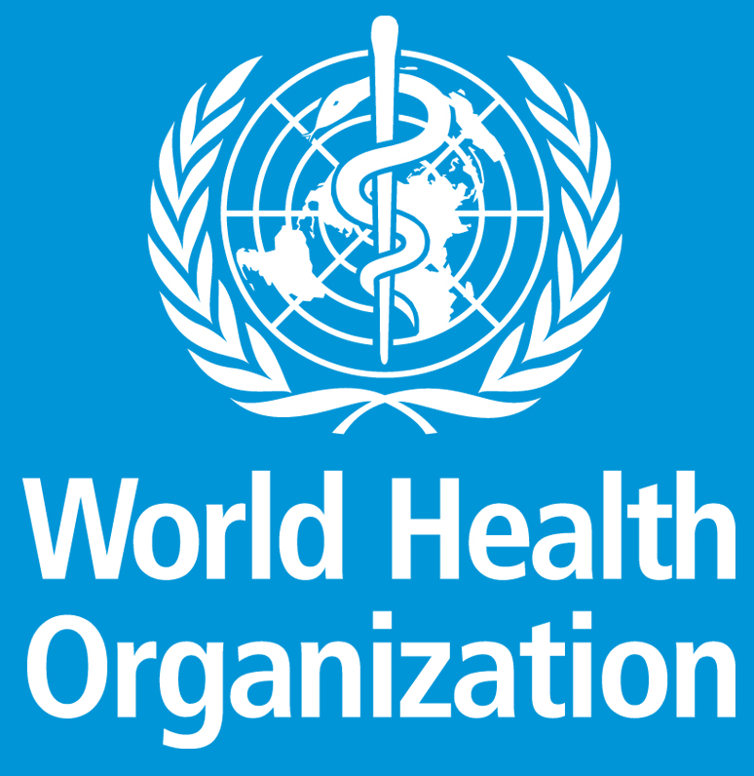
Enforcing UHC
The world Health Organization (WHO), through its constitution declares health a fundamental human right (Ghebreyesus, T. A. (2017).
WHO helps countries to develop their health systems to achieve, maintain and monitor universal health coverage.
WHO collaborates with partners such as
Alliance for Health Policy and Systems Research
P4H Social Health Protection Network
UHC Partnership
Primary Health-Care Performance Initiative
UHC2030
Notes:
UHC is based on the 1948 WHO Constitution, which declares health a fundamental human right and commits to ensuring the highest attainable level of health for all.
Therefore, WHO’s attempt to ensure that UHC is achieved involves helping countries to develop their health systems to achieve, maintain and monitor universal health coverage.

Slide 7

UHC Requirements
Adequate and competent health and care workers with optimal skills mix at facility, outreach and community level, and who are equitably distributed, adequately supported and enjoy decent work ("Universal health coverage (UHC)," 2021).
Strengthening health systems in all countries through robust funding of all key structures such as information systems, data analysis, and surveillance (Ghebreyesus, T. A. (2017).
Policy making based on evidence
Communication and community outreach to empower individuals and families to better manage their own health.
Notes:
Improving health service coverage and health outcomes depends on the availability, accessibility, and capacity of health and care workers to deliver quality people-centred integrated care.
When people have to pay most of the cost for health services out of their own pockets, the poor are often unable to obtain many of the services they need, and even the rich may be exposed to financial hardship in the event of severe or long-term illness. Pooling funds from compulsory funding sources (such as government tax revenues) can spread the financial risks of illness across a population. Thus the need for Strengthening health systems in all countries through robust funding of all key structures.

Slide 8

Impact of WHO on Health Care Law and Policy
The World Health Organization is an agency of the United Nations mandated with international public health.
WHO was able to convene meetings with heads of states, key policy makers and other healthcare stakeholders and convinced them to align healthcare policy and laws with universal healthcare (Ghebreyesus, T. A. (2017).
WHO has successfully managed to influence healthcare policies in more than 110 partner countries across the globe.
Notes:
The World Health Organization is an agency of the United Nations mandated with international public health.
WHO was able to convene meetings with heads of states, key policy makers and other healthcare stakeholders and convinced them to align healthcare policy and laws with universal healthcare.
WHO has successfully managed to influence healthcare policies in more than 110 partner countries across the globe.

Slide 9

Challenges of UHC
Low levels of entitlements
Large healthcare inequality
Limited financial protection
Poor portability
Notes:
A lack of capacity to offer effective financial protection was identified as the most important challenge hindering the achievement of UHC. Indeed, financial protection has been considered a crucial element of universal health coverage.
Health inequities are differences in health status or in the distribution of health resources between different population groups, arising from the social conditions in which people are born, grow, live, work and age. Health inequities are unfair and could be reduced by the right mix of government policies.

Slide 10

Economic Evaluation
In the period between 2000 and 2011, health investments were sorely responsible for a quarter growth in developing countries (Reich et al., 2016).
Advanced medical technologies are available to emerging markets putting pressure on scarce resources in order to finance them ("Universal health coverage (UHC)," 2021).
The general cost of healthcare services is increasing and it is expected to increase further in coming years.
Catastrophic economic and social costs related to health expenditures impoverish 100m people a year worldwide (Ghebreyesus, T. A. (2017).
Notes:
The general cost of healthcare services is increasing and it is expected to increase further in coming years. Catastrophic economic and social costs related to health expenditures impoverish 100m people a year worldwide.
Opportunities for better healthcare services are available through advanced medical technology. However, this technology is not available for emerging markets because of their inability to finance it.

Slide 11
Value of UHC TO THE WHO
WHO aims to advocate and catalyze global and country actions to resolve the human resources for health crisis, to support the achievement of the health-related millennium development goals and health for all ("Alliance vision and mission," n.d.).
The goal of universal health coverage is to ensure that all people obtain the health services they need without suffering financial hardship when paying for them ("Universal health coverage (UHC)," 2021).
Notes:
The mission of UHC to ensure that all people obtain the health services they need without suffering financial hardship when paying for them makes it possible for the WHO to achieve its mission to advocate and catalyze global and country actions to resolve the human resources for health crisis, to support the achievement of the health-related millennium development goals and health for all.

Slide 12
Reference
Universal health coverage (UHC). (2021, April 1). https://www.who.int/news-room/fact-sheets/detail/universal-health-coverage-(uhc)
Alliance vision and mission. (n.d.). WHO | World Health Organization. https://www.who.int/workforcealliance/about/vision_mission/en/
What is universal health coverage? (n.d.). WHO | World Health Organization. https://www.who.int/westernpacific/news/q-a-detail/what-is-universal-health-coverage
Reich, M. R., Harris, J., Ikegami, N., Maeda, A., Cashin, C., Araujo, E. C., ... & Evans, T. G. (2016). Moving towards universal health coverage: lessons from 11 country studies. The Lancet, 387(10020), 811-816.
Ghebreyesus, T. A. (2017). All roads lead to universal health coverage. The Lancet Global Health, 5(9), e839-e840.

